Slide 1

Calculus
Application in real life

Slide 2

Name: Arup Das Apu
Id: 0242220005341023
Course Title: MAT101
Session: Fall 2022
Submitted to Fatema Tuz-Zohora

Slide 3
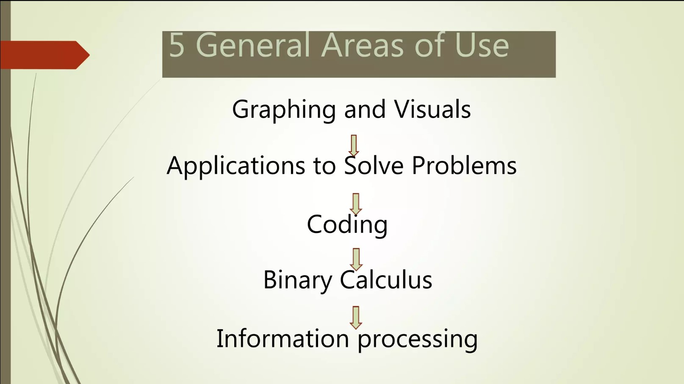

Slide 4
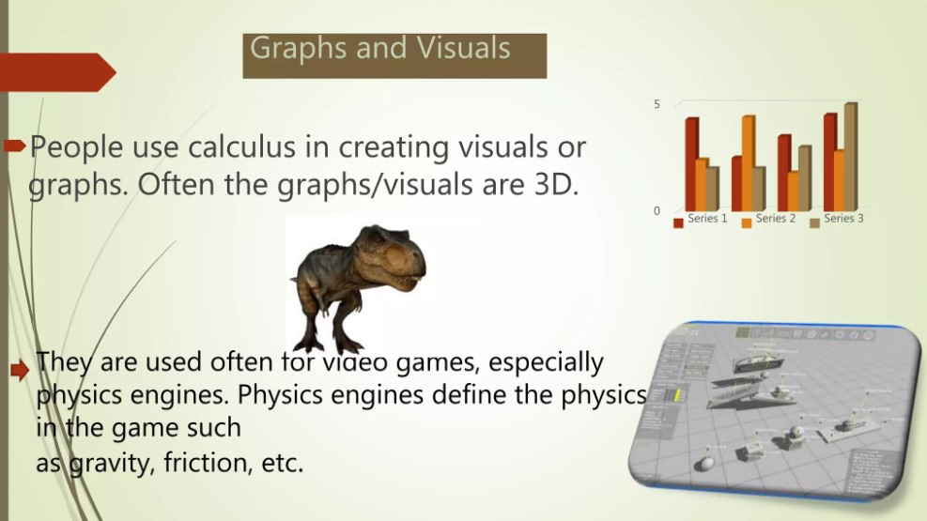

Slide 5
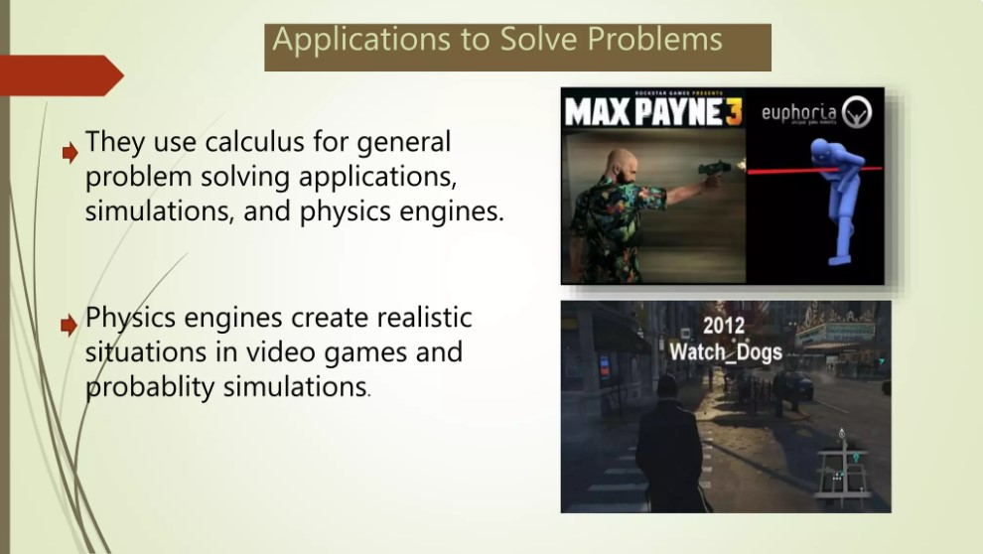

Slide 6
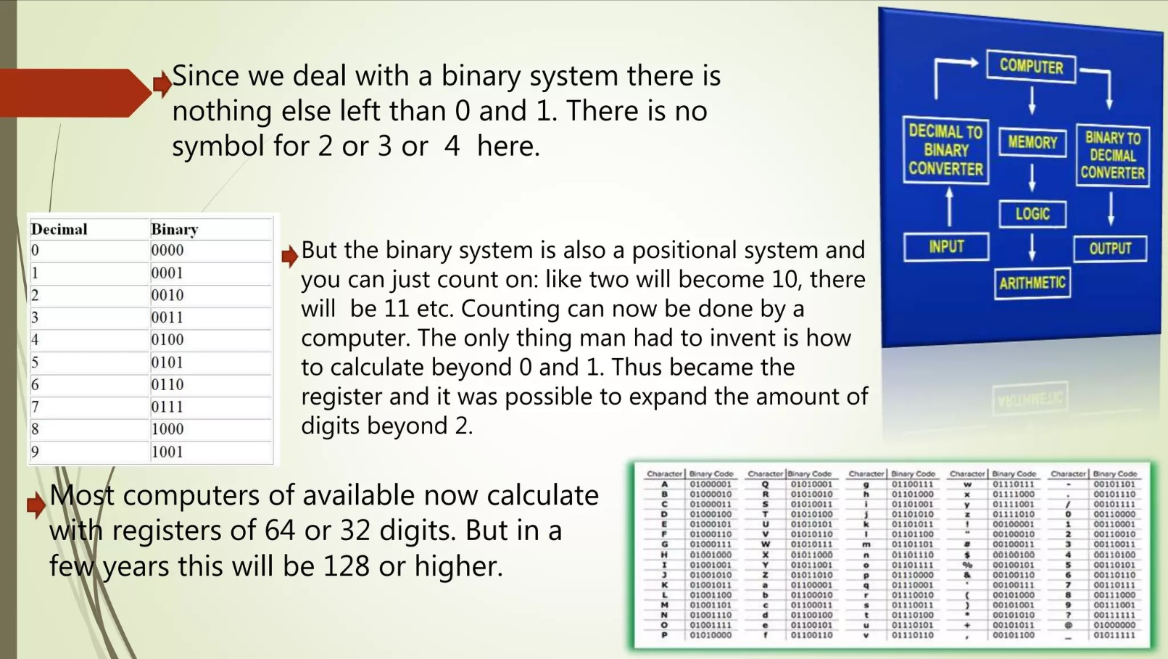

Slide 7
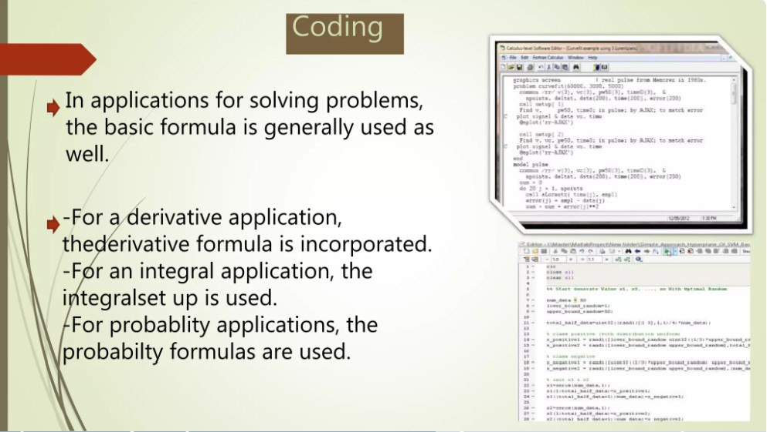

Slide 8
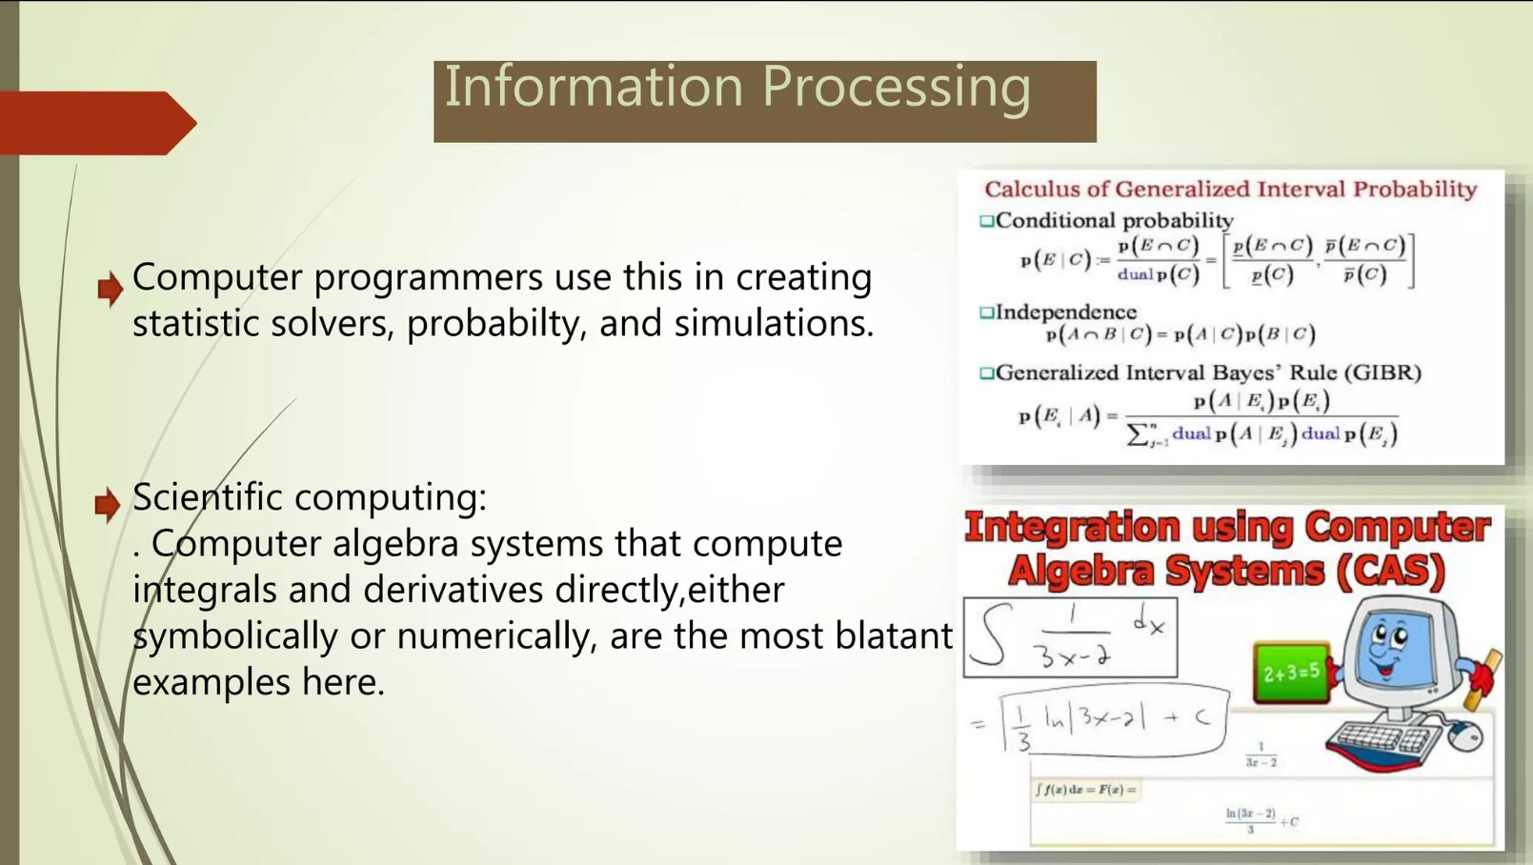

Slide 9

Thank you

